Slide 1
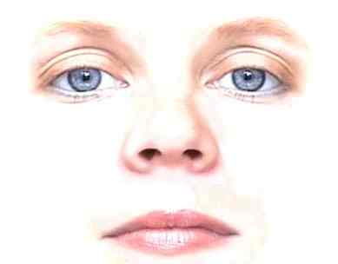
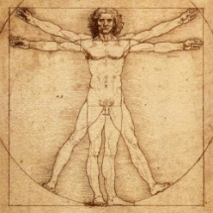

Information
0.42
Face
Body
0.30
Voice
0.28
Leakiness
Low
High

Slide 2
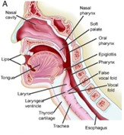
Decoding
Encoding
Face
Visual
Non-verbal
Body
Voice
Audio
Verbal
Speech

